Slide 1

PIZZA SALES PROJECT
MUNAWER JABEEN

Slide 2
INTRODUCTION
THIS PROJECT ANALYZES PIZZA SALES DATA TO UNCOVER TRENDS AND INSIGHTS ABOUT CUSTOMER ORDERING BEHAVIOR.
THE DATASET INCLUDES DETAILS ON ORDERS, ORDER DETAILS, PIZZA TYPES, AND PIZZAS.
SQL WAS USED TO CLEAN, JOIN, AND QUERY THE DATA FOR MEANINGFUL BUSINESS INSIGHTS.
THE OBJECTIVE IS TO IDENTIFY TOP-SELLING PIZZAS, CALCULATE REVENUE, AND HIGHLIGHT KEY PATTERNS IN SALES PERFORMANCE.
THESE INSIGHTS CAN SUPPORT BETTER DECISION-MAKING IN INVENTORY MANAGEMENT, MARKETING, AND MENU PLANNING.

Slide 3
1
Retrieve the total number of orders placed.

Slide 4

ANSWER
select
count(order_id) as total_orders from orders;

Slide 5
2
Calculate the total revenue generated from pizza sales

Slide 6

ANSWER
Select SUM(order_details.quantity*pizzas.price) as total_Revenue
from order_details join pizzas
ON order_details.pizza_id = pizzas.pizza_id

Slide 7
3
Identify the highest-priced pizza.

Slide 8

ANSWER
SELECT pizza_types.name, pizzas.price FROM pizza_types JOIN
pizzas ON pizza_types.pizza_type_id = pizzas.pizza_type_id
ORDER BY pizzas.price DESC LIMIT 1;

Slide 9
4
Identify the most common pizza size ordered.

Slide 10

ANSWER
select order_id,size, count(size) as pop_size
from pizza.order_details od left join pizza.pizzas m
on od.pizza_id = m.pizza_id group by size,order_id
order by pop_size desc limit 5

Slide 11
5
List the top 5 most ordered pizza types along with their quantities.

Slide 12
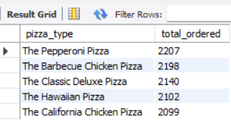
ANSWER
SELECT pt.name AS pizza_type, SUM(od.quantity) AS total_ordered
FROM pizza.order_details od JOIN pizza.pizzas p ON od.pizza_id = p.pizza_id
JOIN pizza.pizza_types pt ON p.pizza_type_id = pt.pizza_type_id GROUP BY pt.name ORDER BY total_ordered DESC LIMIT 5;

Slide 13
6
Join the necessary tables to find the total quantity of each pizza category ordered

Slide 14
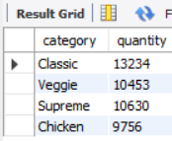
ANSWER
SELECT pt.category, sum(od.quantity) as total_quantity
FROM pizza.order_details AS od LEFT JOIN pizza.pizzas as p
ON od.pizza_id = p.pizza_id LEFT JOIN pizza.pizza_types AS pt ON p.pizza_type_id = pt.pizza_type_id group by pt.category
order by total_quantity desc

Slide 15
7
Determine the distribution of orders by hour of the day.

Slide 16
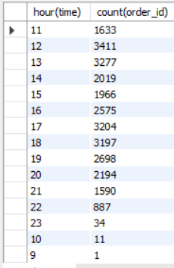
ANSWER
SELECT HOUR(TIME), COUNT(ORDER_ID) FROM ORDERS GROUP BY HOUR(TIME);

Slide 17
8
Join relevant tables to find the category-wise distribution of pizzas.

Slide 18
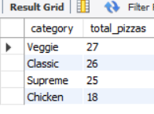
ANSWER
SELECT pt.category, COUNT(p.pizza_id) AS total_pizzas
FROM pizzas p JOIN pizza_types pt ON p.pizza_type_id = pt.pizza_type_id GROUP BY pt.category ORDER BY
total_pizzas DESC;

Slide 19
9
Group the orders by date and calculate the average number of pizzas ordered per day.

Slide 20
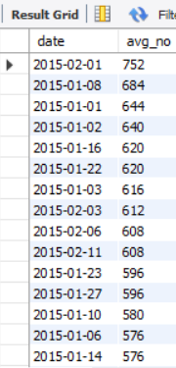
ANSWER
select o.date, count(date) as avg_no from pizza.order_details od left join pizza.orders as oon od.order_id = o.order_id
group by date order by avg_no desc

Slide 21
13
Determine the top 3 most ordered pizza types based on revenue.

Slide 22
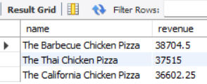
ANSWER
SELECT pizza_types.name, SUM(order_details.quantity * pizzas.price) AS revenue FROM pizza_types JOIN
pizzas ON pizza_types.pizza_type_id = pizzas.pizza_type_id JOIN order_details ON order_details.pizza_id = pizzas.pizza_id
GROUP BY pizza_types.name ORDER BY revenue DESC LIMIT 3;

